Slide 1

TSP Exact
By: Tanner Karol

Slide 2
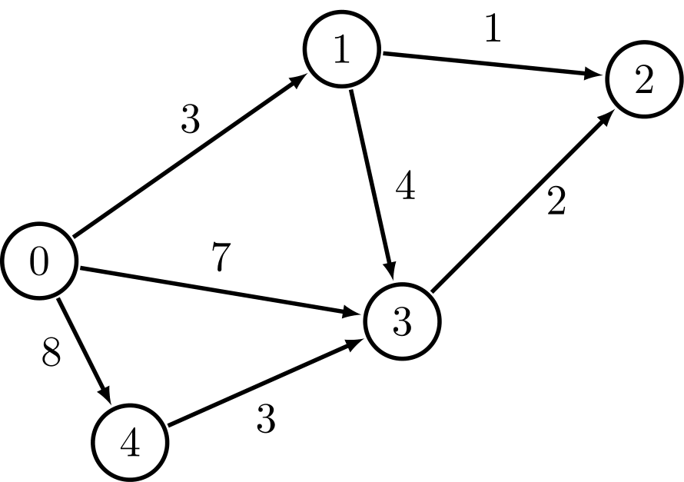
What Is TSP?
In short the traveling salesman problem where a “salesman” needs to visit the full set of “cities” (nodes) exactly once, starting and ending at the same city (node).
The goal of this problem is to minimize the total distance.
Decision problem: “Is there a route that visits all cities and has a total distance ≤ K?
Optimization Problem: “What is the shortest possible route that visits all nodes?”

Slide 3
Benchmarks for TSP Exact Solution
The brute-force approach is effective for smaller graphs but quickly becomes impractical as the number of vertices increases, due to exponential growth in the number of possible routes.
Test Case | Number of Vertices | Exact Cost | Exact Runtime (s)
testCase3 | 5 | 155.0 | 0.00006
testCase4 | 8 | 307.7 | 0.0065
testCase5 | 10 | 275.5 | 0.36
testCase6 | 25 | Not Computed | Not Computed
testCase7 | 50 | Not Computed | Not Computed

Slide 4
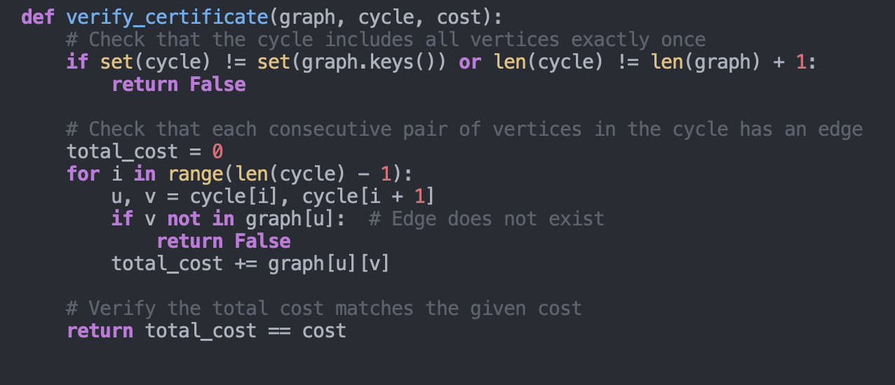
Verifying the Certificate for TSP
What is a certificate?
A list of vertices representing a Hamiltonian cycle.
The total cost of the cycle.
What does the certifier do?
Checks that all vertices are visited exactly once.
Verifies that edges exist between consecutive vertices in the cycle.
Ensures the total cost matches the given value.
Why is it polynomial?
Each check takes O(n), where n is the number of vertices.
The process grows linearly with the size of the input.

Slide 5
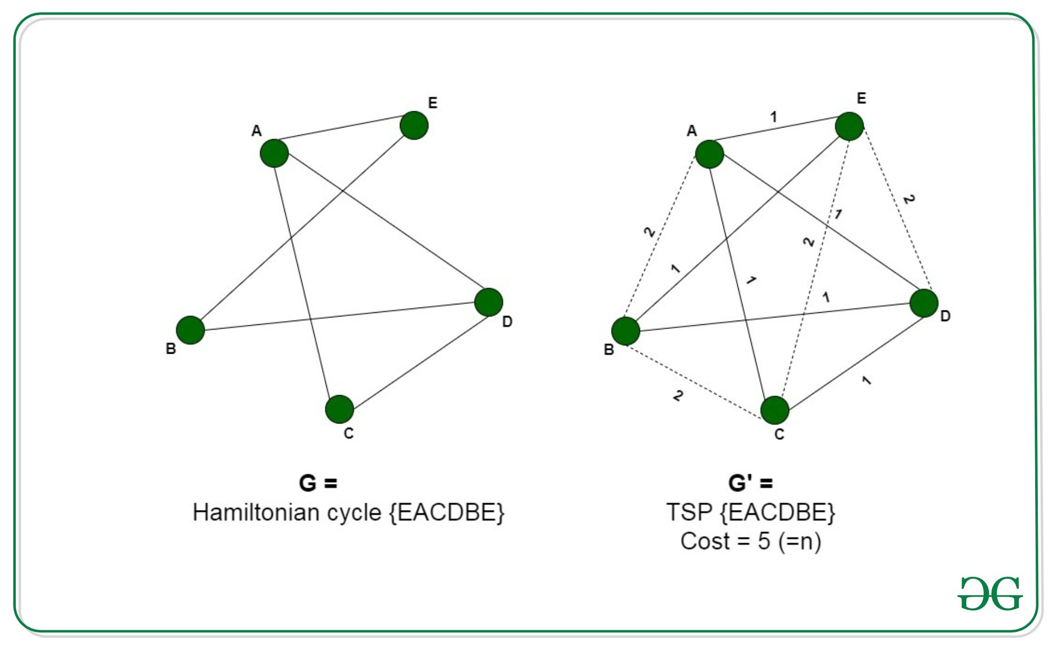
Reduction from Hamiltonian Cycle to TSP
Pre-requisite:
The TSP requires finding the shortest path that visits every vertex exactly once and returns to the starting point.
The Hamiltonian Cycle problem checks if a cycle exists that visits every vertex exactly once without considering weights.
Reduction Steps:
Input for Hamiltonian Cycle:
Graph G = (V, E), where V are vertices and E are edges.
Constructing Graph G′ for TSP:
Retain edges of G with a cost of 1.
Add all missing edges to make G complete, assigning them a cost of 2.
Set the maximum cost K=N where N is the number of vertices.
Verify:
If the TSP solution for G′ has a cost K=N, the original graph G contains a Hamiltonian Cycle.

Slide 6
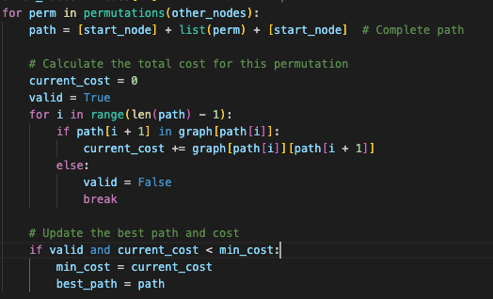
Analytical Runtime Analyis
The runtime of my exact TSP solution is O(n⋅n!).
Why?
Generating all permutations of n-1 nodes takes (n-1)! Time.
For each permutation, computing the total cost of the cycle takes O(n).
This gives a total complexity of O(n⋅n!).
Dominant Portion of the code.

Slide 7
